Slide 1

Taking Off (and Landing) with SpaceX: An Exploratory Data Analysis of SpaceX Launch Trends
Presented by: That’s my name
Date of Presentation: I think it’s today?
You can contact the presenter: email@goes.here
Link to data on Github:https://github.com/NoelEvan321/Coursera_Capstone_SpaceX/tree/master

Slide 2
Table of Contents
Section 1: Data Collection
A. With Pandas
B. With Web Scraping
C. With SQL
Section 2: Wrangling
Section 3: Visualization
With Seaborn
With Folium
Section 4: Dashboard
Section 5: Prediction
Section 6: Discussion

Slide 3

Abstract
This report will highlight the tools and approaches used in current data science. The project focuses on modern and significant problems surrounding what is proposed to be one of the world’s most lucrative markets. In this report we will cover what approaches can be used to mine, clean, analyze, visualize, and predict data and trends. The data is obtained from SpaceX launch sites, and we will focus on the relationship between launch success rates and other relevant parameters to allude to a cost-benefit analysis of SpaceX commercial flights.

Slide 4
Introduction and Research Review
The purpose of this report is to explain a typical data science work-flow and provide examples of the techniques and resources used in the work-flow. The report will follow the layout of a typical report with the difference being the intent. A common data science report would showcase findings to data-driven questions. This report is designed to provide a general overview.
The data being used is from SpaceX launch resources and will be used to view and analyze intriguing relationships within the data.
This report is part of the criteria to obtain the IBM Data Science Professional certification through Coursera. All data was processed and assessed with guidance from the course staff.

Slide 5

DATA COLLECTION

Slide 6

Data Collection with Python
In the following slides we will be discussing data collection and storage using the Pandas library.

Slide 7
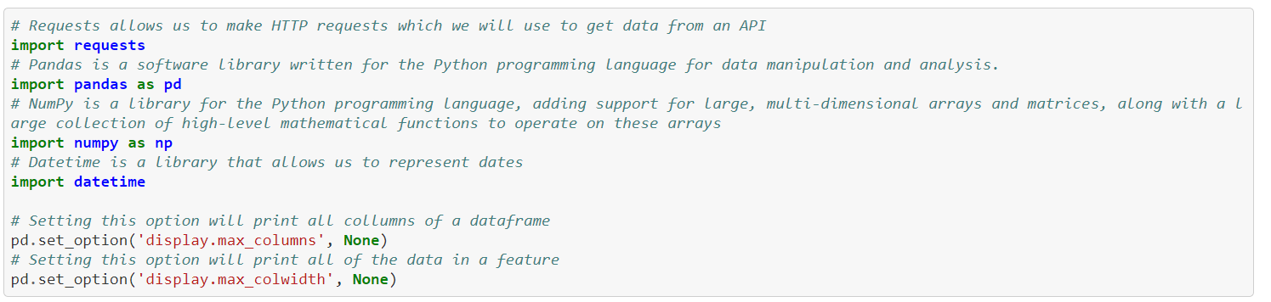
Library Imports

Slide 8
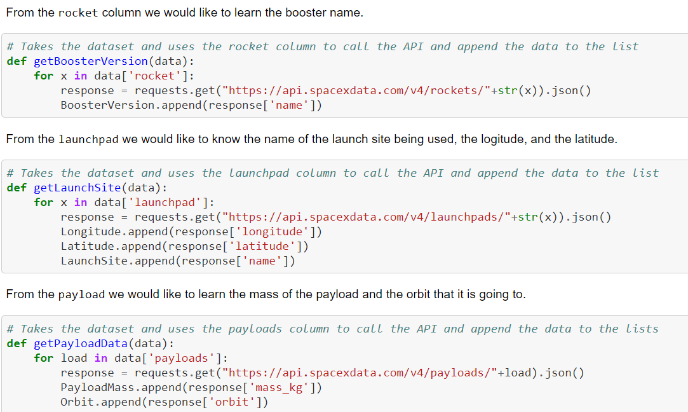
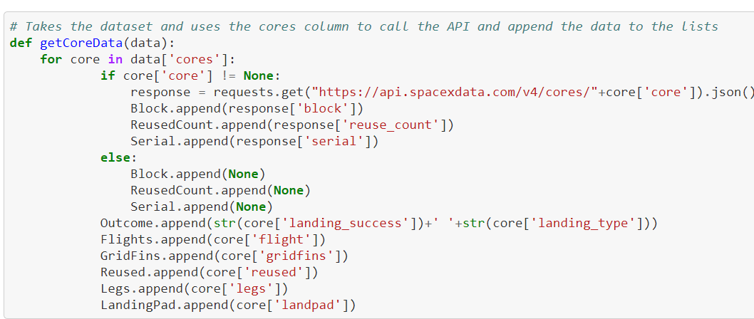
Functions to Select Data

Slide 9
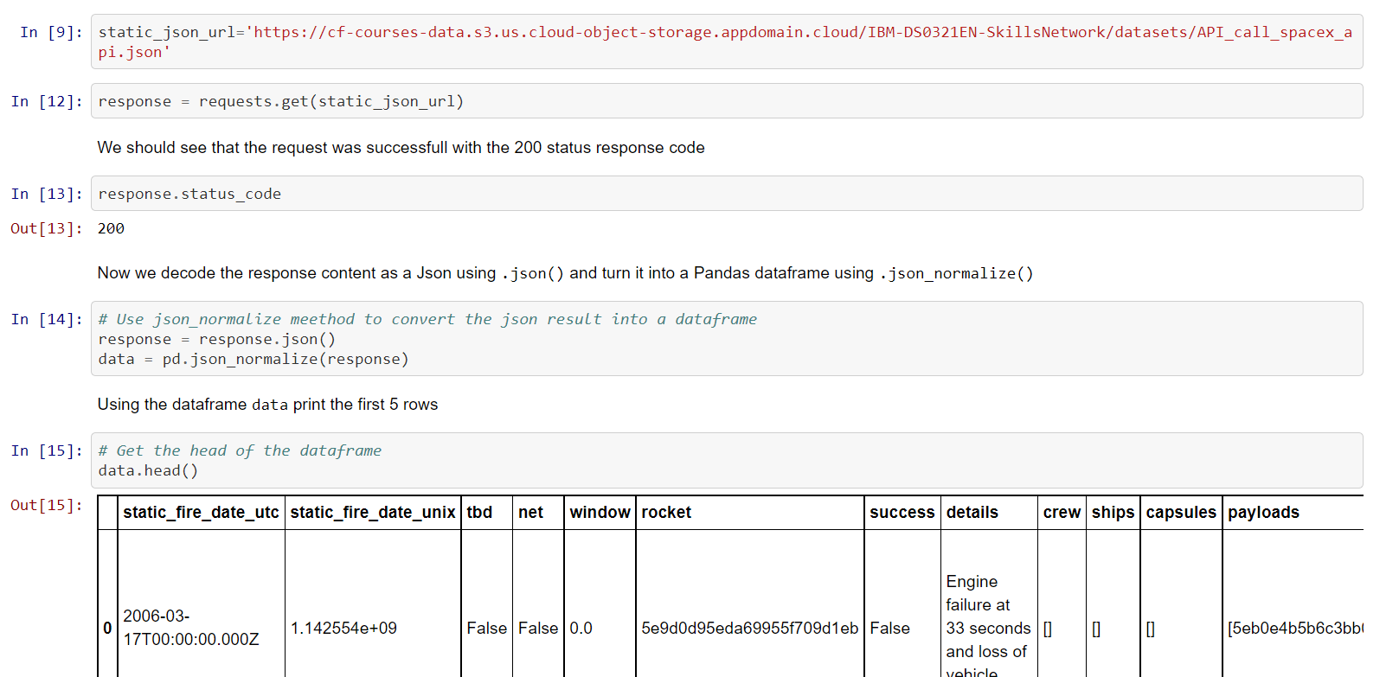
Loading JSON

Slide 10
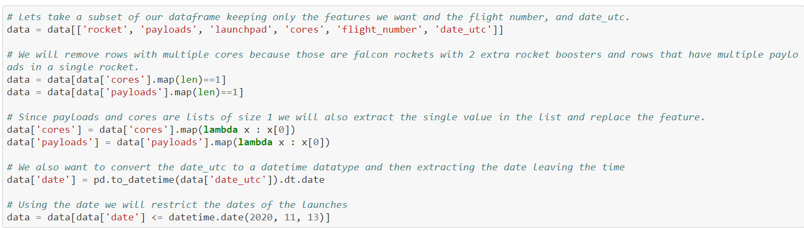
Building DF

Slide 11
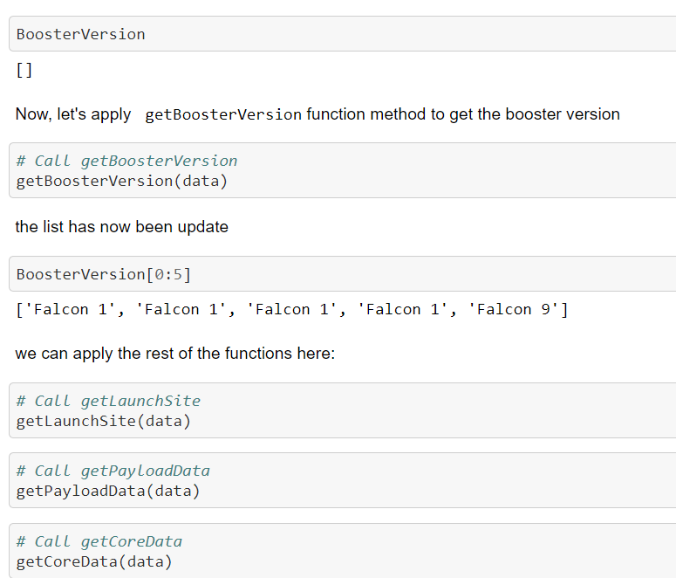
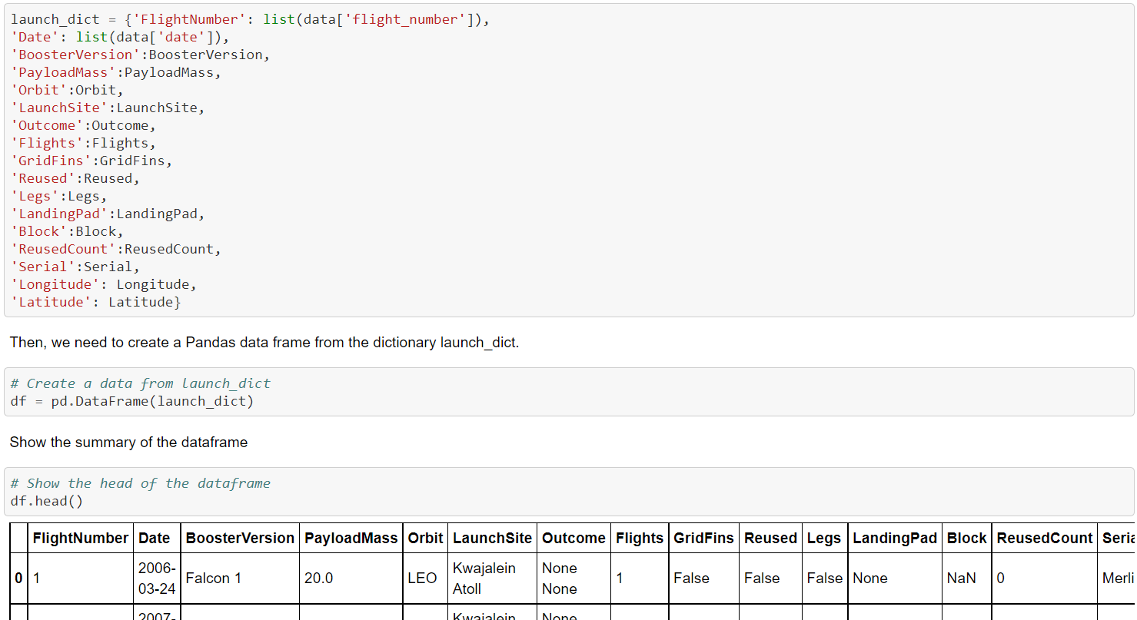
Inserting the Data

Slide 12
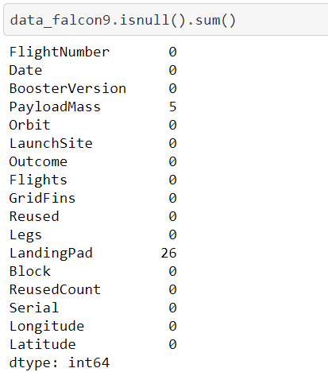
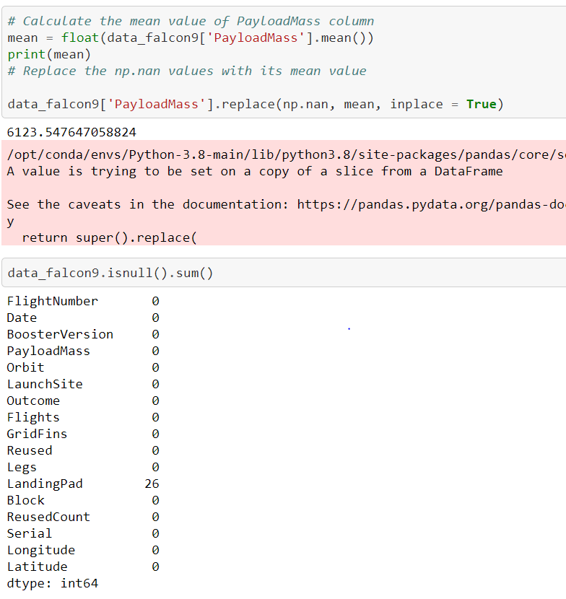
Dropping the Nulls

Slide 13
Data Collection with Pandas
In slide 7 we can see the functions defined to pull data from a pre-existing data frame. We use the data frame, ‘data’, to pull information for attributes, ‘rocket’, ‘launchpads’, ‘payloads’, and ‘cores’

Slide 14
Obtained a JSON using Request
After our functions have been defined we can request our target URL. We can then normalize our request response to go from JSON to DataFrame. The DataFrame will be named ‘data’.

Slide 15
Built and Cleaned our new DF
Next, we can build our new data frame from the existing df ‘data’.
We then can clean our columns ‘cores’ and payloads to include single values. Since the new values are still lists we store the first value in the single-value list.
Finally, we can convert the dates in ‘date-UTC’ to datetime.

Slide 16
Applied the Functions
After we have defined our functions and cleaned existing data, we can run the functions and store the previously mentioned columns into a new data frame named ‘df’.

Slide 17
Dropped Nulls and Stored the DF
As shown, we can replace null values with fitting, numerical values. In df[payloadmass] there were 5 null values that we replaced with the average payload mass for all other launches.
After the df has been cleaned, we can then store it as a CSV with pandas’ ‘to_csv’.

Slide 18

Data Collection with Web Scraping
In this section we’ll cover common practices and general use of the Beautiful Soup library for Python3

Slide 19
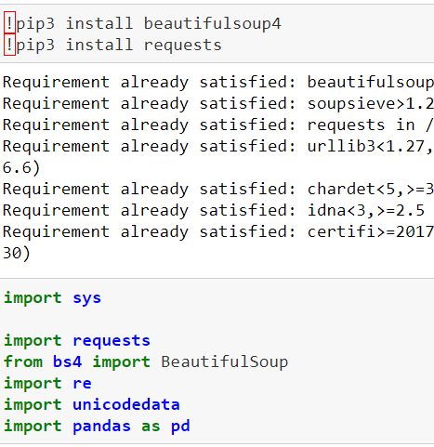
Importing requests and BeautifulSoup

Slide 20
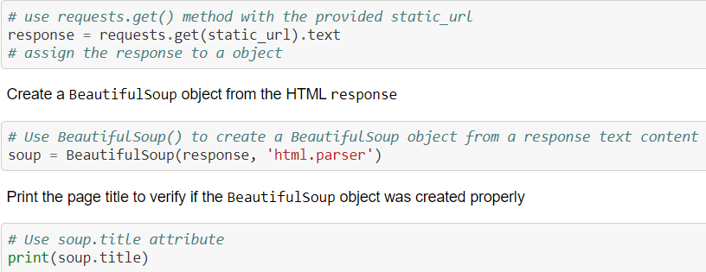
Obtaining the URL
Here we can use requests to obtain the URL assigned to ‘static_url’ as text. We can then make the response variable into a soup BeautifulSoup object to be parsed.

Slide 21
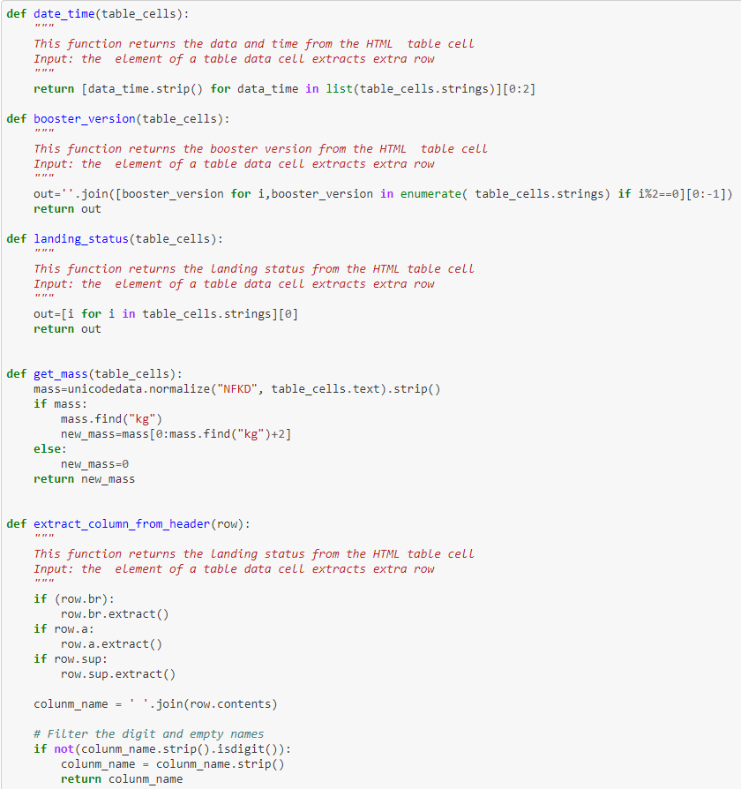
Defining the Functions
Here we can define functions to pull particular values from the table we will parse from our soup object.

Slide 22
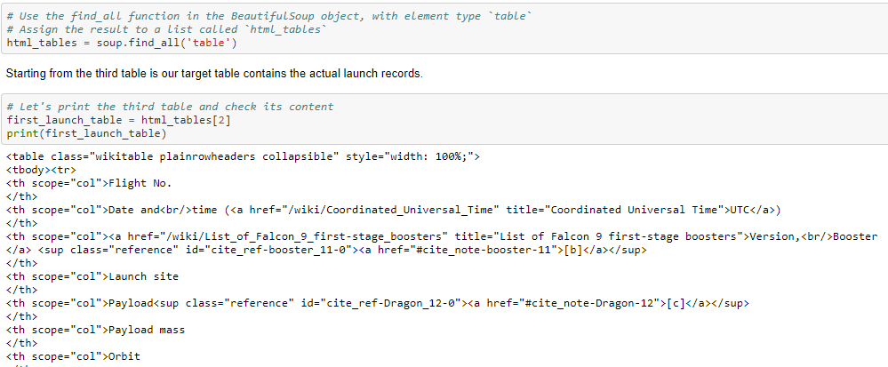
Obtaining the Tables
In the code above we see a way to pull all the tables in our soup object. The tables are stored as a list in ‘html_tables’. Then, visually identifying our table of choice we assign that table to the variable ‘first_launch_table’.

Slide 23
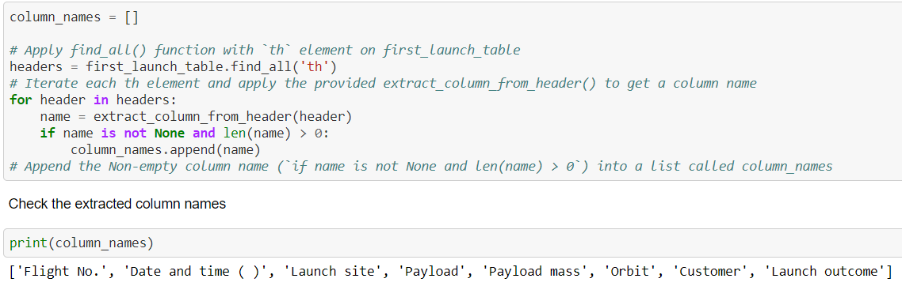
Obtaining Column Names
In the code below we see that we can use BeautifulSoup to parse through a table. We have a table, ‘first_launch_table’, pulled from the soup object using the find_all method. We can then use the find_all method again to find all headers in our table. Those headers will be used as our column names.

Slide 24
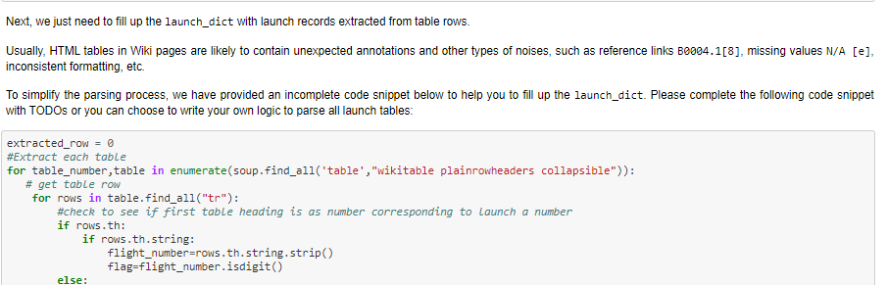
Creating a DataFrame
After we’ve obtained the information we need from our soup, we can then begin building a new DataFrame. In the code to the right we see the creation of ‘launch_dict’. We begin ‘launch_dict’ by assigning the column names as keys. We then assign each of those keys an empty list. Additionally we drop the ‘date and time’ key and add the keys, ‘Version Booster’, ‘Booster landing’, ‘Date’, and ‘Time’.
Finally, for each row in our table we can apply the functions we defined earlier.

Slide 25
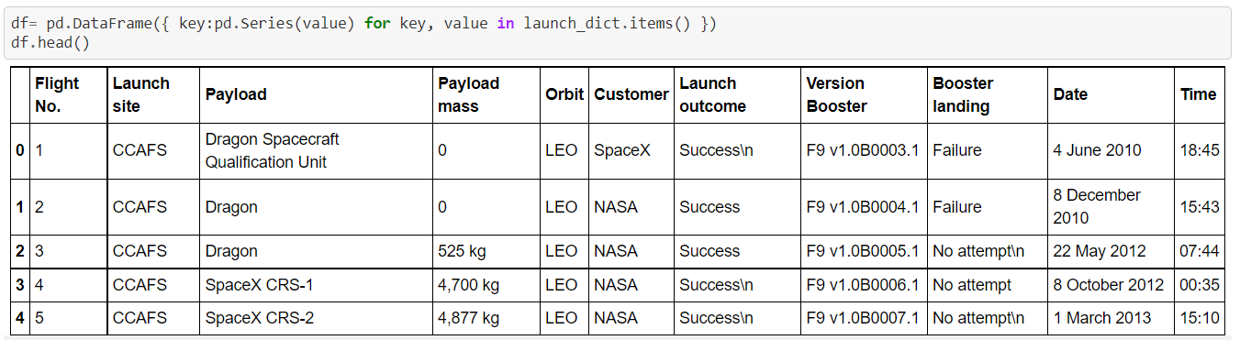
Viewing the New DataFrame

Slide 26
Navigating Databases with SQL
In the following section we will discuss navigation of tables using the Structured Query Language (SQL).

Slide 27
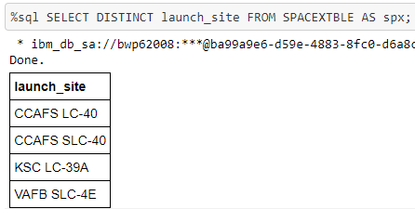
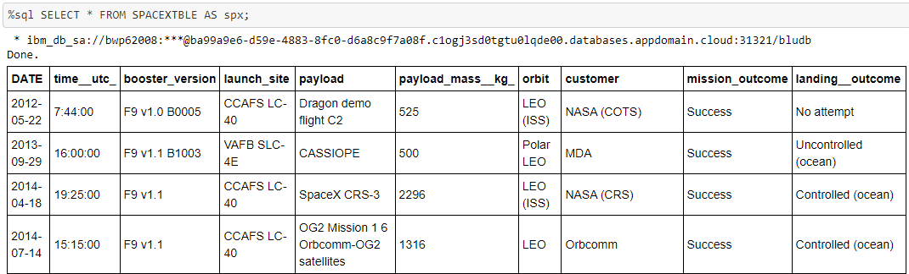
Select in SQL
In the code below we use Select to pull all values from the SPACEXTBLE in our database.
We also use Distinct to pull unique values from our column of choice, ‘launch_site’.

Slide 28
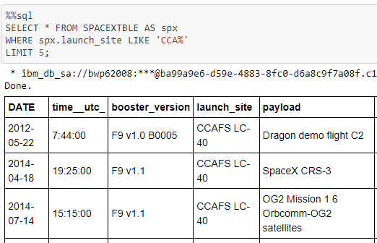
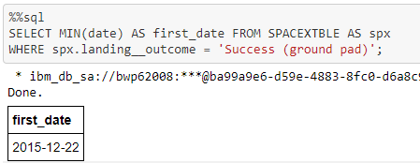
Select Where with SQL
In the code below we use the WHERE clause and the LIKE and LIMIT conditions on the SPACEXTBLE to pull the first 5 rows with values in the ‘launch_site’ colunm starting with the letters CCA.
Another example of using WHERE can be seen when we pull the minimum date from SPACEXTBLE with a landing_outcome of “Succcess (ground pad)”.

Slide 29
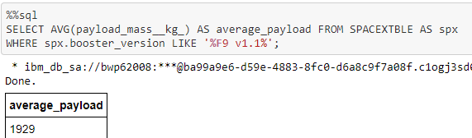
Selecting aggregates with SQL
In the image we see the use of the aggregate function ‘AVG’ to obtain the average payload mass for flights with booster version F9 v 1.1.

Slide 30
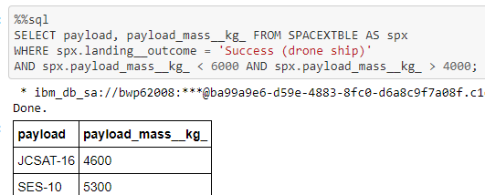
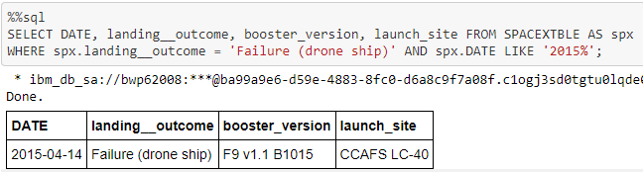
Multiple conditions with SQL
Here we show how to write a query with multiple conditions.

Slide 31
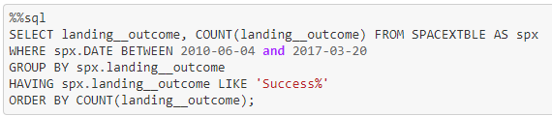
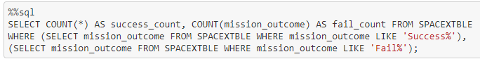
Complications
Was unable to complete Tasks 7 and 10.
The data overall was lacking 45 rows from the original source. Could not convert date types for those columns.

Slide 32
CREATING AND USING A DASHBOARD

Slide 33
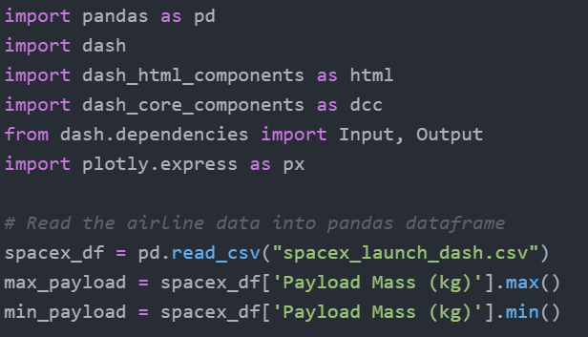
Dashboard imports
Used Atom text editor to edit python file
Loaded the libraries and packages listed above
Used Pandas to read a csv as a dataframe.

Slide 34
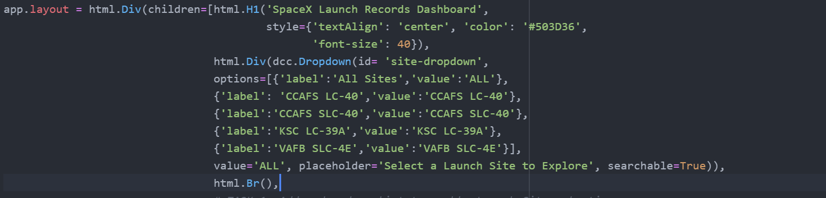
Dashboard Dropdown
Added an html child with .Div
Using dcc.Dropdown created a dropdown menu to select ‘All’ or specific launch sites to view.

Slide 35
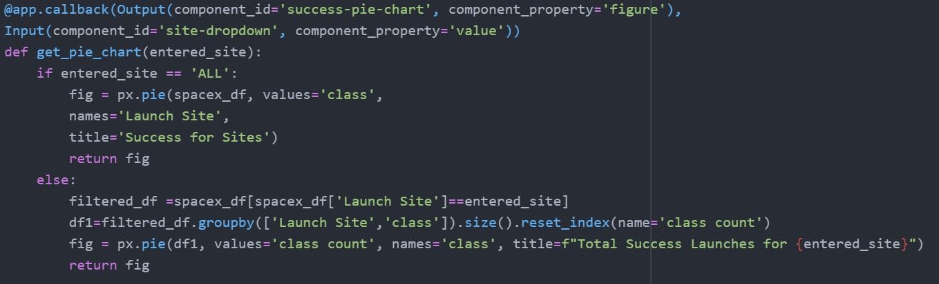
Dashboard PieChart
Using html.Div and dcc.Graph can create a generic pie chart
Using a callback function we can set the output to be the same id as the above graph.
We create a function with callback inputs as our desire source for our arguments.
We write code to check the dropdown input.
If a site has been selected we create a sub-DataFrame to groupby the size of the ‘Launch Site’ and ‘class’ attributes.
Output a pie chart for the selected attributes within the filtered DataFrame
Next slide to show the output.

Slide 36
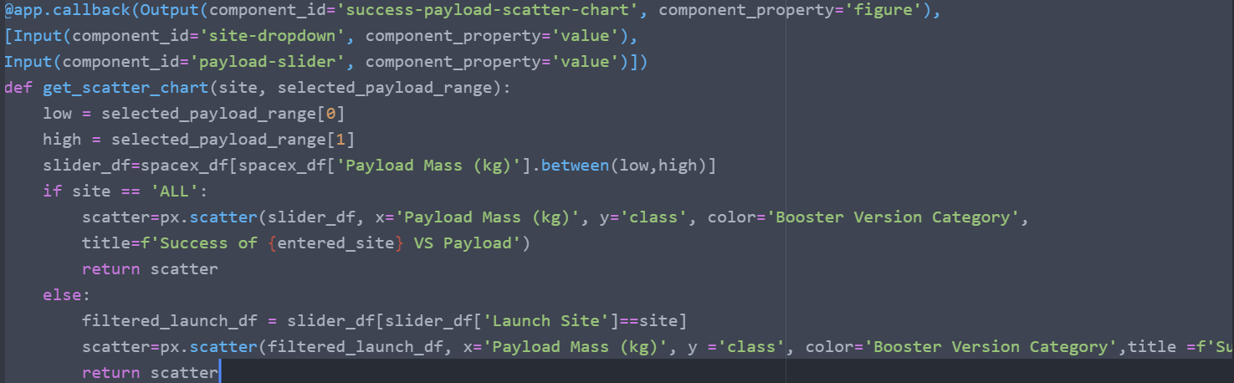
Dashboard ScatterPlot
From what I was able to tell, the code should be correct but clearly isn’t since I can’t get the scatter plot to display.
Peer input would be greatly appreciated.

Slide 37

EDA - Wrangling
In this section we will be applying aggregate functions to the DataFrame to obtain valuable insights.
We will be using value_counts to separate outcomes associated with a successful launch from outcomes associated with a failed launch.
This Photo by Unknown Author is licensed under CC BY-ND

Slide 38
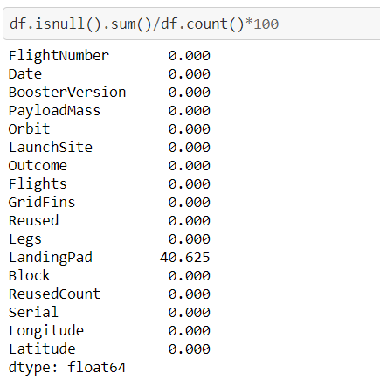
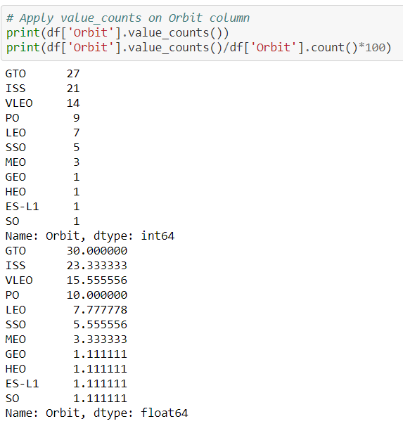
Value Count and Nulls
Here is an example of using value_counts to create dictionary of each unique value as the key and the number of times that value is present as the value associated with the key.

Slide 39
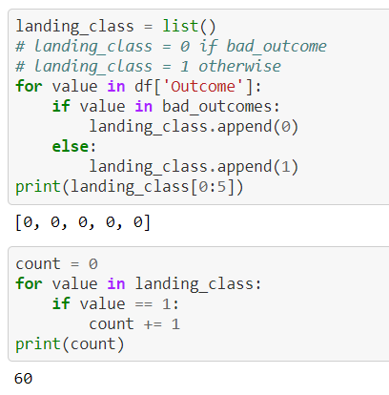
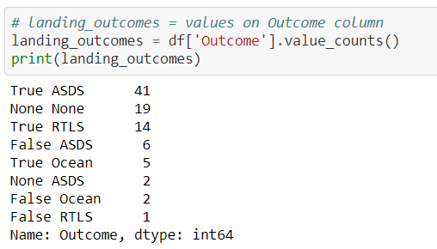
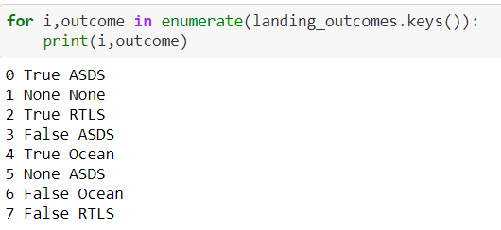
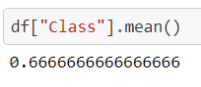
Creating the Class Column
Here we use value_counts to create the dictionary ‘landing_outcomes’. We then iterate through the keys of landing_outcomes to view each current outcome class. Based on which of the outcomes result in a success or failure (pre determined) we create a failure list called bad_outcomes. The list ‘landing_class’ is appended to include 0 or 1 based on failure or success.

Slide 40
Data Visualization

Slide 41
EDA- Visualization
In this section we will use Seaborn to build figures and visualize particular relationships of the data in our DataFrame.

Slide 42
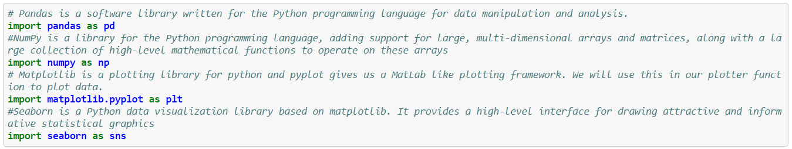
Imports

Slide 43
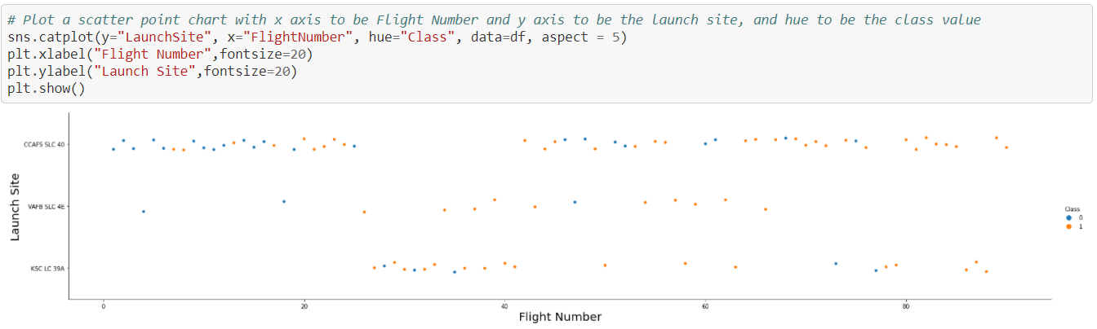
Launch Site Vs Flight number
Here we use Seaborn to build a scatterplot comparing Launch Site and Flight Number. By doing this we can visualize any significant relationships between Flight Number, Launch Site, and success vs failure for each site. It would seem that the later launches have a higher success rate than earlier launches.

Slide 44
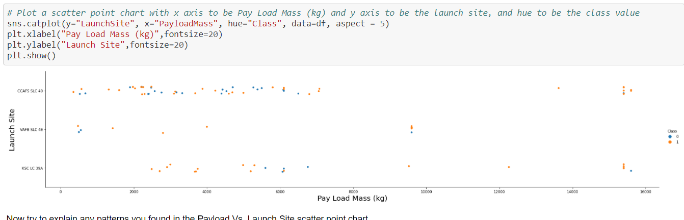
Launch Success by Payload Mass per Site
Here we use Seaborn to build a scatterplot comparing Launch Site and Payload Mass. By doing this we can visualize any significant relationships between Payload Mass and Success rate by Launch Site. It would seem the later launches have a higher success rate than earlier launches.

Slide 45
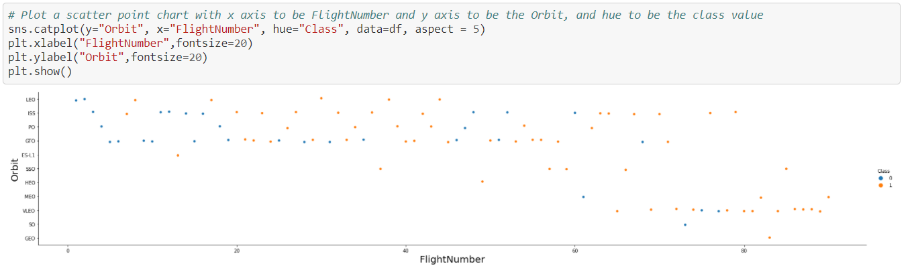
Launch Success by Orbit
Here we use Seaborn to build a scatterplot comparing Orbit and Flight Number. By doing this we can visualize any significant relationships between Flight Number and Success rate by Orbit. It would seem there are more launches to lower orbits for earlier flights than later flights.

Slide 46
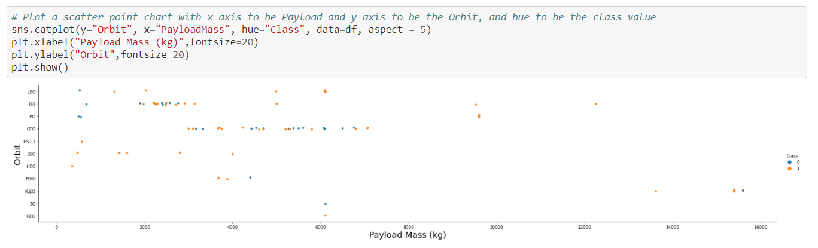
Launch Success in Orbits by Payload Mass
Here we can see that heavy payloads are most successful in VLEO orbit.

Slide 47
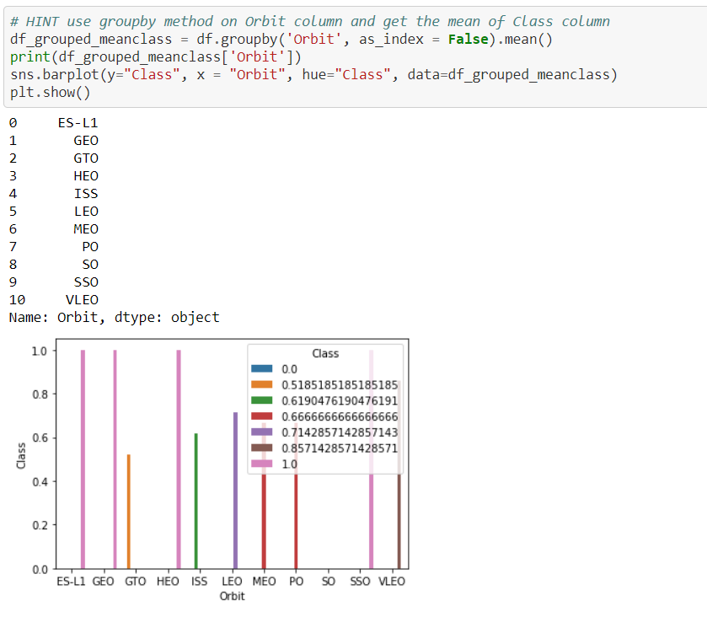
Viewing Success for each Orbit.
Here we can use groupby to group each orbit by its average success. We use Seaborn barplot to represent each orbit and its average success as a bar graph.

Slide 48
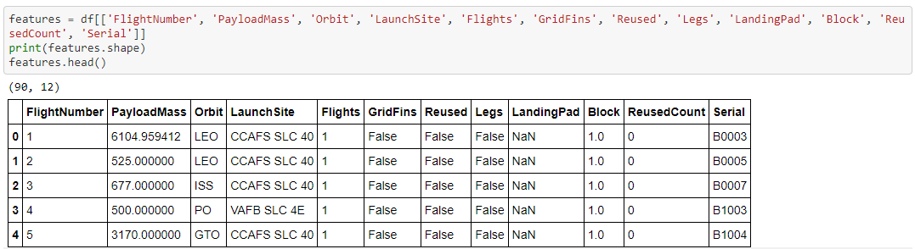
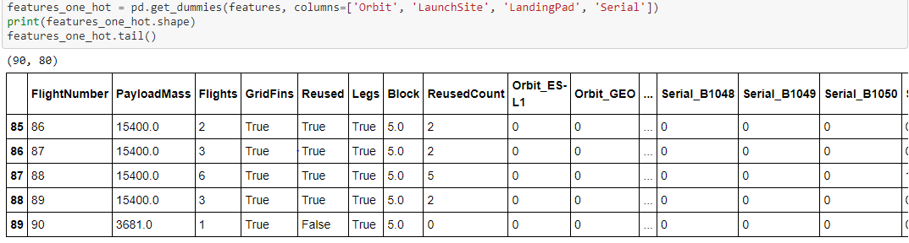
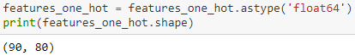
One-hot-encoding
One-hot-encoding is technique in which we convert categorical values into individual attributes and for each row we assign a class of zero or one. We can use this to build a DataFrame that can be related and used to build prediction models.

Slide 49

EDA with Folium Maps
In this section we explore the use of Folium Maps to visualize geographical data.

Slide 50
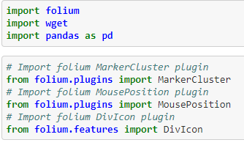
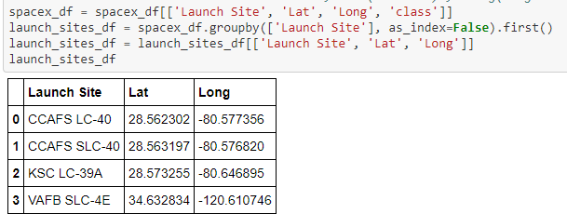
Imports and Data Load

Slide 51
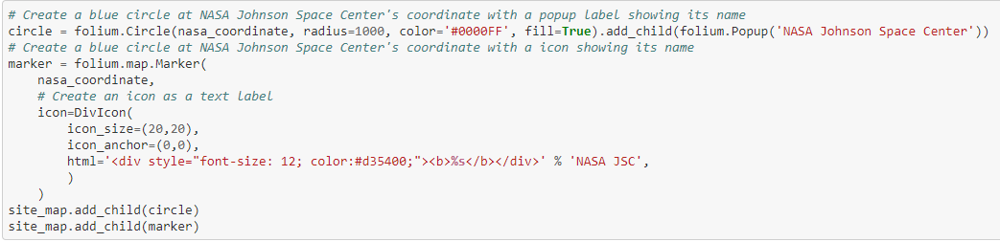
Creating the Map Object
Here we create a circle and an icon to mark ‘NASA Johnson Space Center’ on a Folium map.

Slide 52
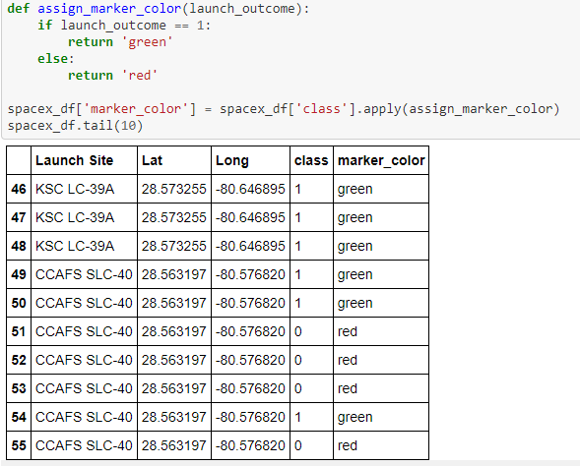
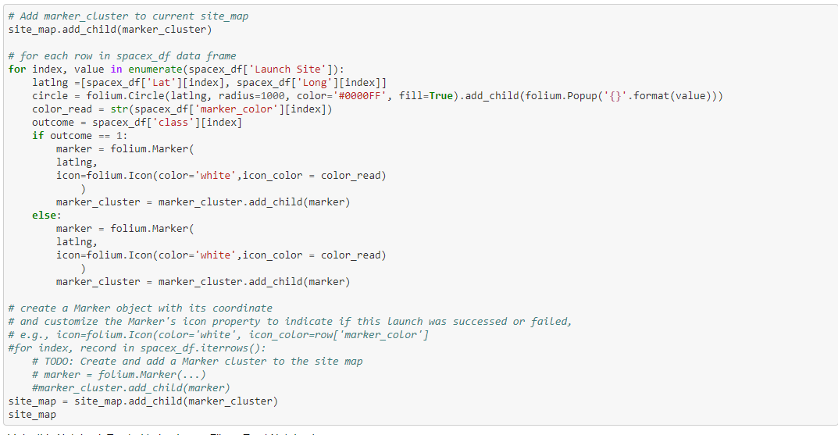
Marker Clusters
We can assign a color to each class and use marker clusters to display success/fail instances for each launch site.

Slide 53
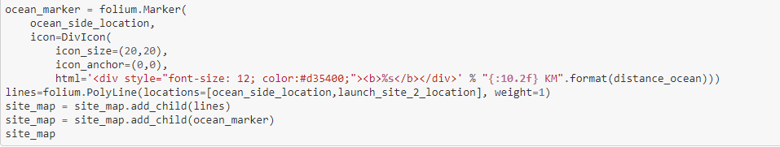


Overlaying Objects
Here we create a mouseposition to view the coordinates we’re pointing to on the map. We can then create a line to connect from our launch site to the location of choice. We previously calculated the distances between to lat/lng pairs.

Slide 54

Nasa Launch Site Map

Slide 55

Marker Cluster Example

Slide 56

Railway Image

Slide 57

Ocean Image

Slide 58
Prediction Models
In the following slides we explore different methods used to build the most effective prediction model.

Slide 59

Imports

Slide 60


Data Used
This slide is to highlight the data we’ve been building and will use to build our prediction models.

Slide 61

Defining the Confusion Matrix
Here we define a function to help calculate the number of true positives and negatives and false positives and negatives.

Slide 62


Building Test and Train Sets
We can transform our dummy data against our class list. Using our new X and Y we can create a random test set and train set with 20% to 80% split respectively.

Slide 63

Logistic Regression Build
Here we use a GridSearchCV object to determine the best parameters for our logistic regression model.

Slide 64

Logistic Regession Confusion Matrix
In the image above we applied our model to our test data. We can see from score and the confusion matrix that our prediction with our model is 83% accurate.

Slide 65

Support Vector Machine Build
Here we use a GridSearchCV object to determine the best parameters for our svm model.

Slide 66

Support Vector Machine Confusion Matrix
In the image above we applied our model to our test data. We can see from score and the confusion matrix that our prediction with our model is 83% accurate.

Slide 67

Tree Build
Here we use a GridSearchCV object to determine the best parameters for our tree model.

Slide 68

Tree Confusion Matrix
In the image above we applied our model to our test data. We can see from score and the confusion matrix that our prediction with our model is 83% accurate.

Slide 69

K Nearest Neighbors Build
Here we use a GridSearchCV object to determine the best parameters for our knn model.

Slide 70

K Nearest Neighbors Confusion Matrix
In the image above we applied our model to our test data. We can see from score and the confusion matrix that our prediction with our model is 83% accurate.

Slide 71

Model Comparison
By printing the score for each method, we can see that each as accurate as the next.

Slide 72
Discussion
To conclude there are many different ways to skin a cat, but the idea is the same. In this report we have reviewed the general method for Data Science using SpaceX data as a platform. We discussed different means of obtaining data, different ways to explore that data, and different ways to visualize it. We also discussed machine learning methods used to quickly relate data. After a model is built, we can repeat the process and continue to refine our models and understand our information more and more.

